Slide 1

SHRI VISHNU ENGINEERING COLLEGE FOR WOMEN
BIBLIOSEEK
L.SANJANA | 22B01A4257 | FRONTEND
K.KAVYA SRI | 22B01A4241 | BACKEND
T.JYOTHSNA | 22B01A4240 | GIT OPERATOR
M.SAI ANVIKA | 22B01A4259 | LATEX DESIGNER
K.RAMYA SATYA SRI | 23B05A4205 | DOCUMENTATION

Slide 2
ABSTRACT
Our project is a library management system developed using Python’s tkinter and PIL libraries. It functions as a web application where users login to access various features. After authentication, users can search for books by their title and author. If a book is found in the database, users are redirected to a page displaying its details and location within the library. Our system also includes a feedback mechanism, allowing users to read and provide feedback on books they have read. This feedback serves as recommendations for other users. By providing a platform for users to search, read, and contribute feedback, our project aims to enhance the library experience and promote community engagement.

Slide 3
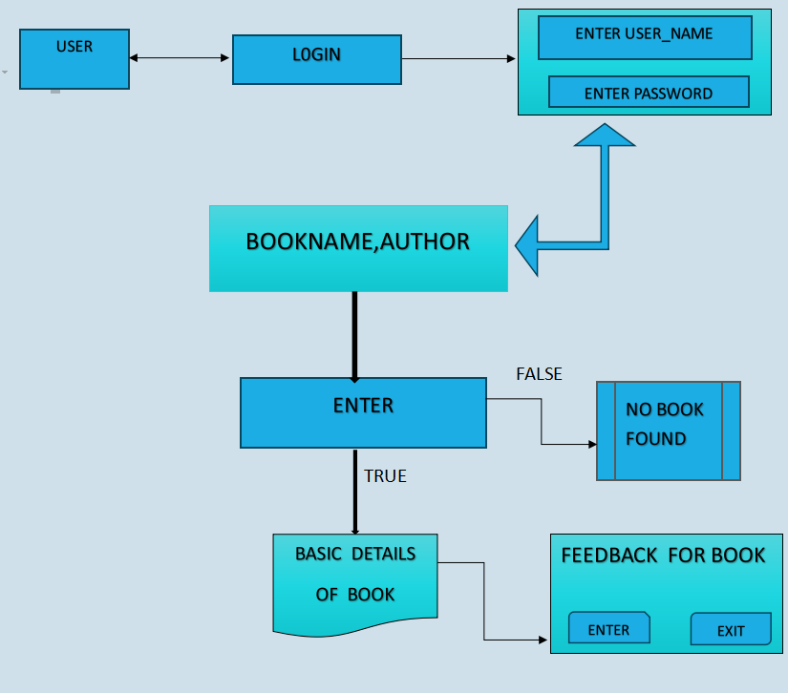
DATA FLOW DIAGRAM

Slide 4
UNIQUENESS
Users can share experiences through ratings and comments. Enhances user engagement and provides valuable insights. Prioritizes both user experience and system security.
Secure login ensures only authorized access, fostering privacy and data protection.
Strikes a balance between user-centric design, security, and advanced functionalities.
Unique and comprehensive solution for library management.

Slide 5
TECH STACK
Python 3.x Tkinter
PIL (Python Imaging Library) MySQL(database)

Slide 6

OVERVIEW
COVER PAGE

Slide 7
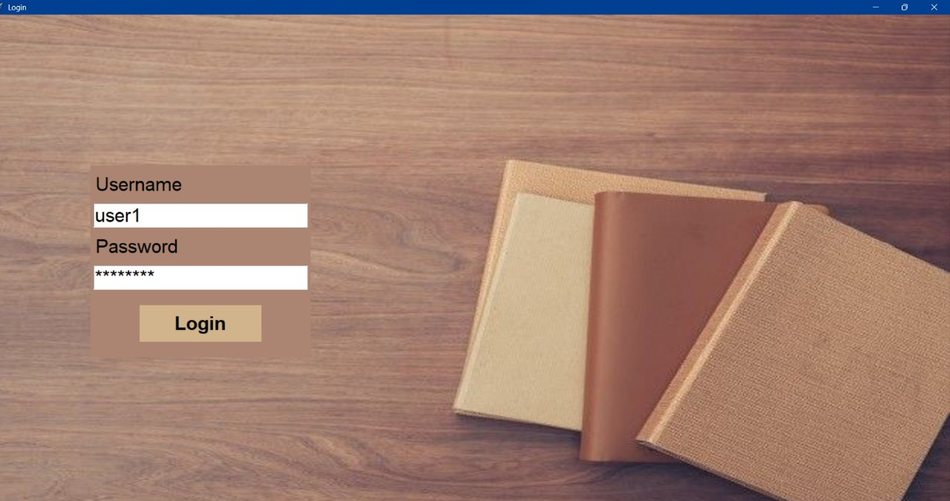
LOGIN PAGE

Slide 8
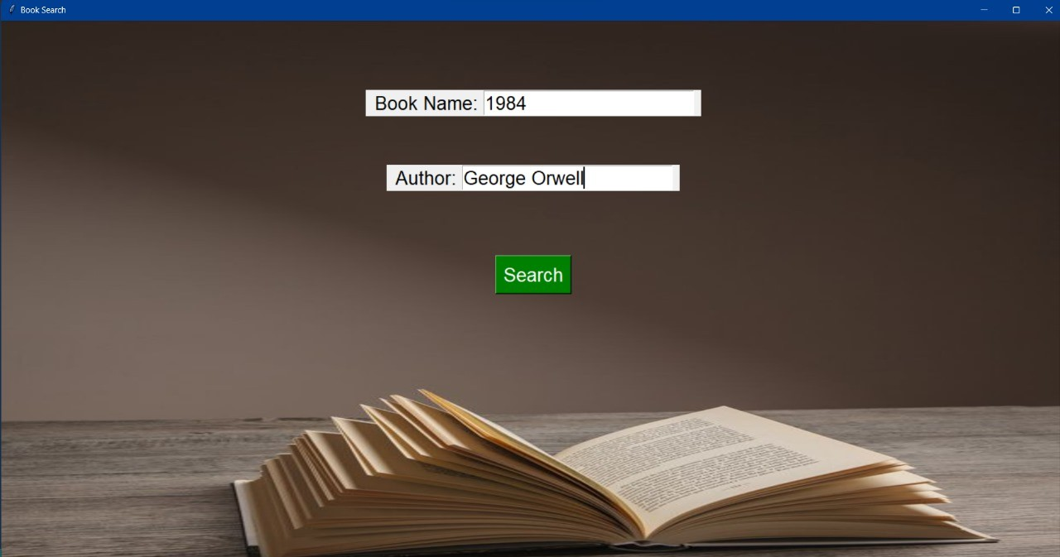
ENTRY PAGE

Slide 9
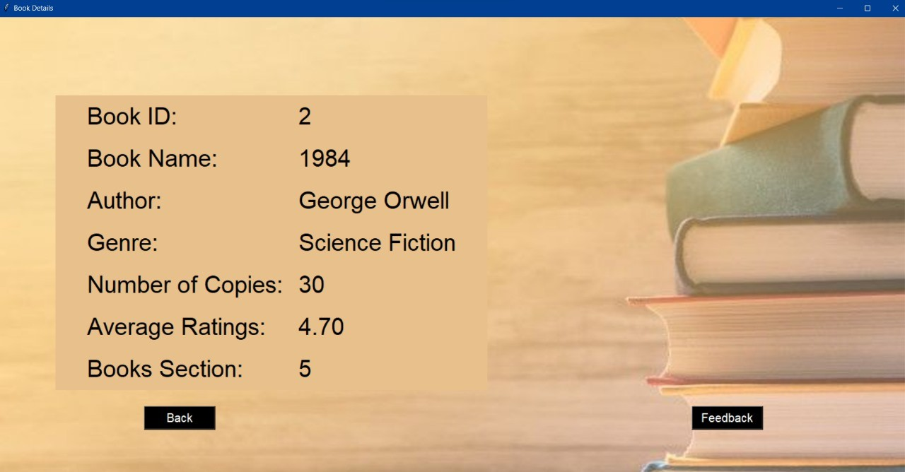
DETAILS

Slide 10
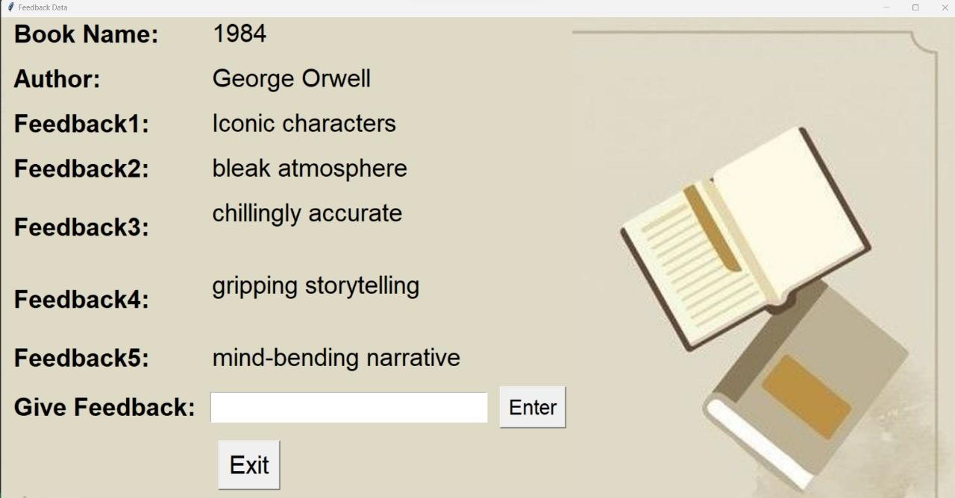
FEEDBACK

Slide 11
BIBLIOGRAPHY
https://readme.so/editor
https://www.activestate.com/resources/quick-reads/how-to- position-widgets-in-tkinter/: :text=Tkinter
https://youtu.be/UjuPn6qyeYw?si=y6LfAVrN6Ju-pQJn https://youtu.be/Rtpu2cWz7W8?si=S0j3bt2m6K4B0CgM CHATGPT
BLACKBOX.AI

